Slide 1
Outfall Reconnaissance Monitoring The why and how of testing direct sources into watersheds…
Chris Jones, Richard Dewitt, & Leslie Schick

Slide 2
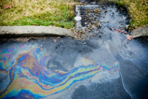
Our common cause…
A Storm Water Pollution Prevention Plan (SWPPP) or Municipal Separate Storm Sewer System (MS4) require an Illicit Discharge Detection Elimination (IDDE) Program.

Slide 3
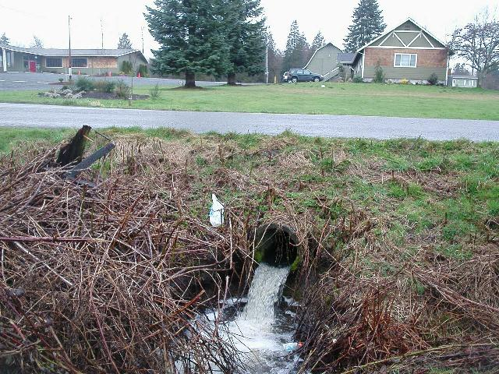
What is an Illicit Discharge?
A discharge to an MS4 that is not composed entirely of stormwater except permitted discharges and fire fighting related discharges 40 CFR 122.26(b)(2)
Unique frequency, composition & mode of entry
Interaction of the sewage disposal system & the storm drain system
Produced from “generating sites”

Slide 4
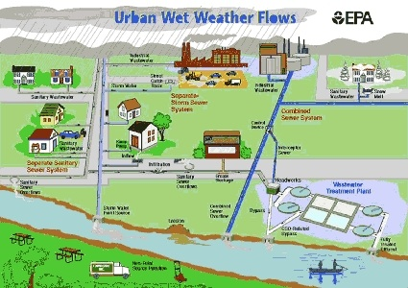

Slide 5
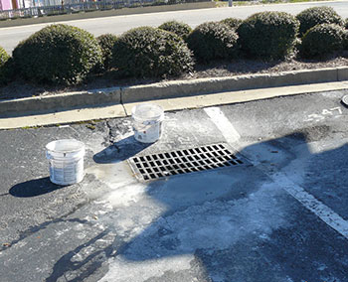
Dry Weather vs Wet Weather
Dry Weather could potentially contribute more pollutants than wet weather as sources could be:
Sewage/septage
washwater (aka gray water)
Paints
automotive waste
Oils (including animal)
landscaping irrigation

Slide 6
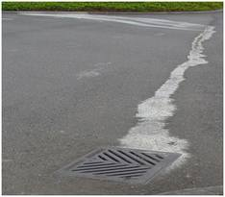
Storm drain systems empty directly into natural waterways (streams, rivers, and wetlands), and do not go to a water treatment plant.
So, any pollution that makes its way into storm drains can damage the environment and pose risks to human health.
Rain water can easily carry pollution from parking lots, streets, and lawns, such as litter, oil, or fertilizer into storm drains and from there into waterways that we use for drinking water, fishing, swimming and so on.

Slide 7
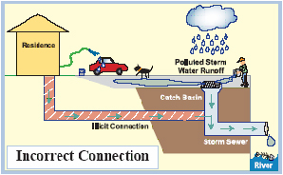
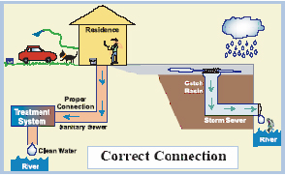
www.accesskent.com Could still have Illicit Discharges…
Goal 1 - Identify Sources
Goal 2 - eliminate /correct

Slide 9
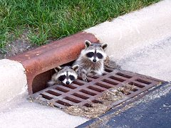
Chris Jones on the “planning” stage of monitoring…

Slide 10
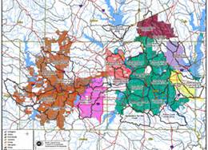
The Survey Phase:
Table Top Reconnaissance
Field Survey
Mapping

Slide 11
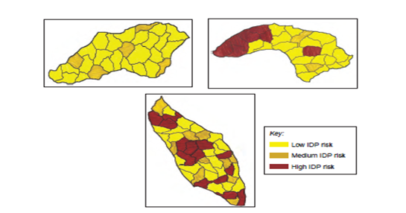
Communities with Minimal, Clustered, and Severe Illicit Discharge Problems
Table Top
Basic Orientation
Indentifying Key Areas

Slide 12
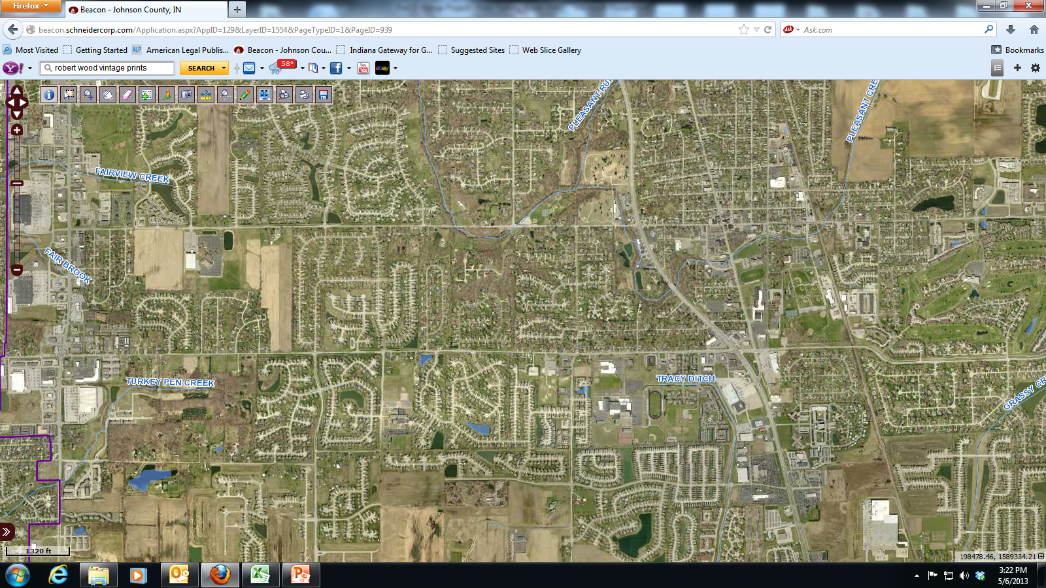
Identifying clusters help to identify pollution potential
Residential - Subdivisions
Commercial -Industrial

Slide 13
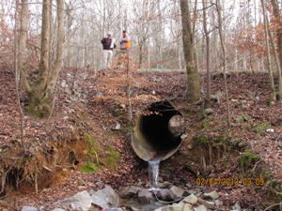
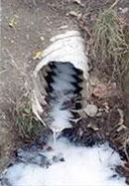
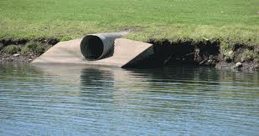
Field Survey
Boots on the ground reconnoiter.
Items needed, boots, water, map and pencil.
Walk the banks, paddle a kayak, make a note on the map for each outfall (pipe) sticking out of the bank or flowing into the waterway.

Slide 14
Mapping
Basic, take the information gained from the table top, and field surveys and pin it on a map.
Utilize Geographic Information Systems or basic Google maps and pins.

Slide 15
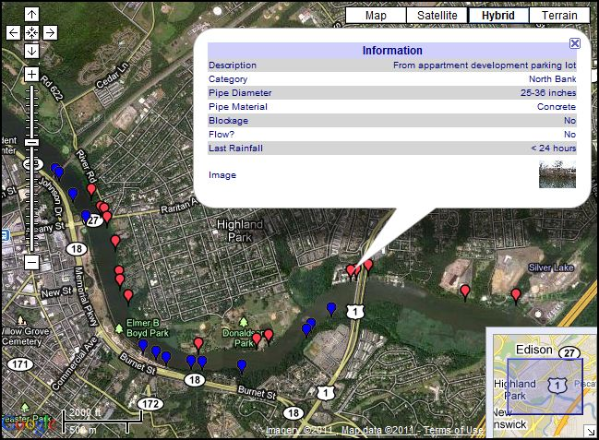

Slide 16
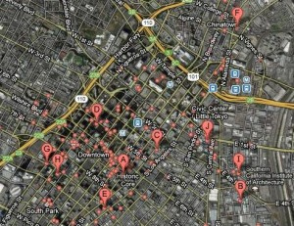

Slide 17
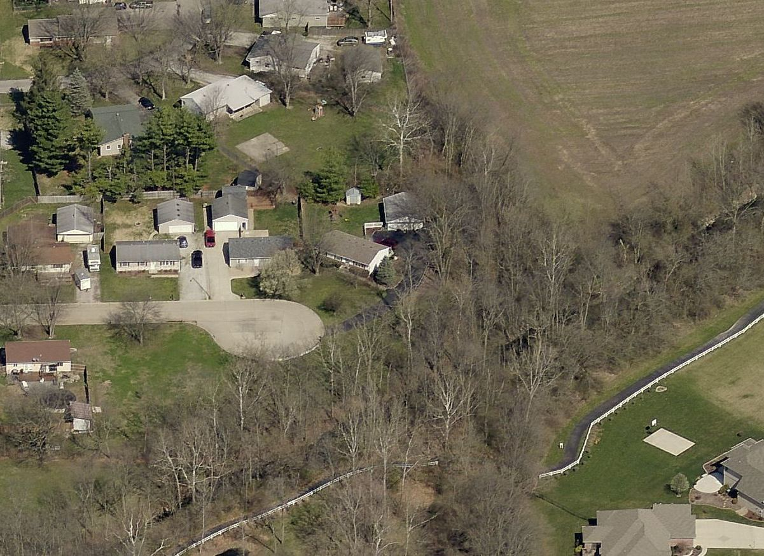
The Testing Phase:
Establish monitoring standards.
Monitoring potential (non-point source) pollution.
Correlation to stream quality.

Slide 18
Outfall ID - ST12500
Outfall with channel to stream.
Notice of any concern?

Slide 19
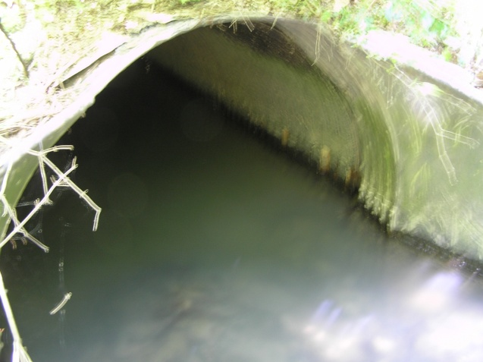
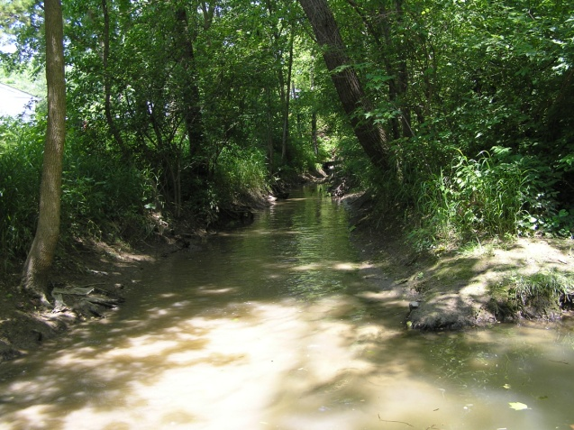

Slide 20
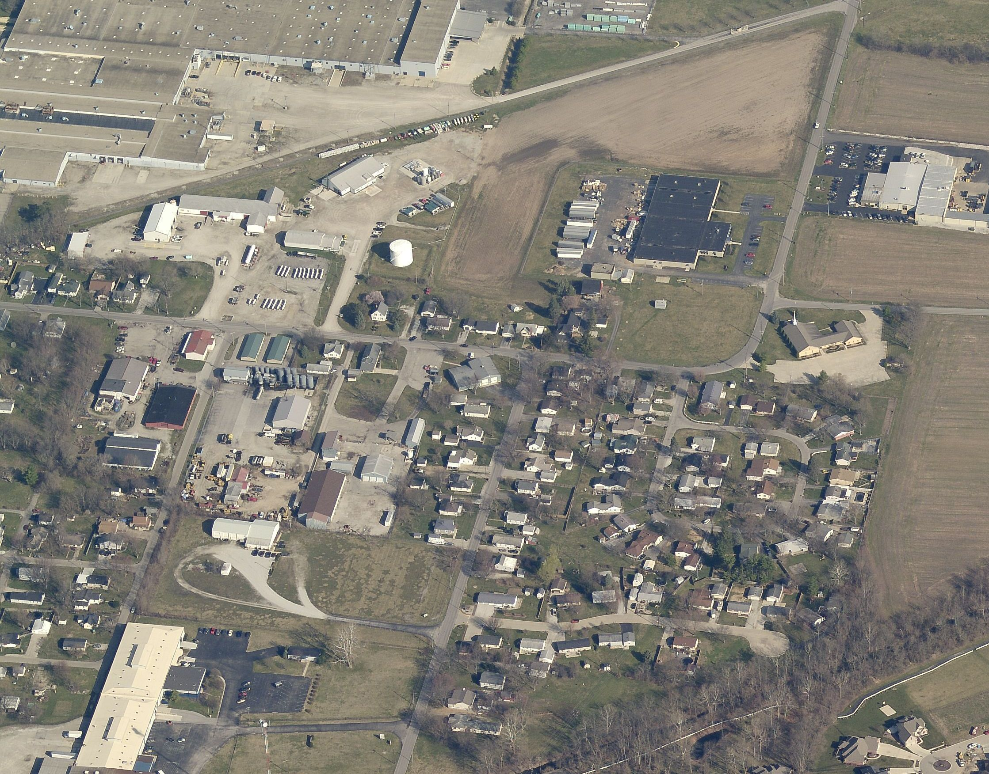
Why a concern for monitoring?
Outfall

Slide 21
Run-off from?
Industrial Complex
Industrial
Agri-Business
Remediation Site
Commercial
&
Construction
Residential
Outfall

Slide 22
Outfall Inspection
Outfall Condition – Cracks, Stains, Odors , Is it dry or flowing.
Abnormal Vegetation or Poor Pool Quality.
Outfall Testing – (with flow).
Testing Parameters
Temperature
pH
E. Coli
Chlorine
Ammonia
Nitrate/Nitrite
Hardness
Turbidity
Detergents
Phosphorus
Testing standards are based upon current Indiana Water Quality Standards.
Test kits are the standard along with visual observation of color & smell.
WWTP – Provides advanced E.Coli testing in their lab for the MS4.

Slide 23
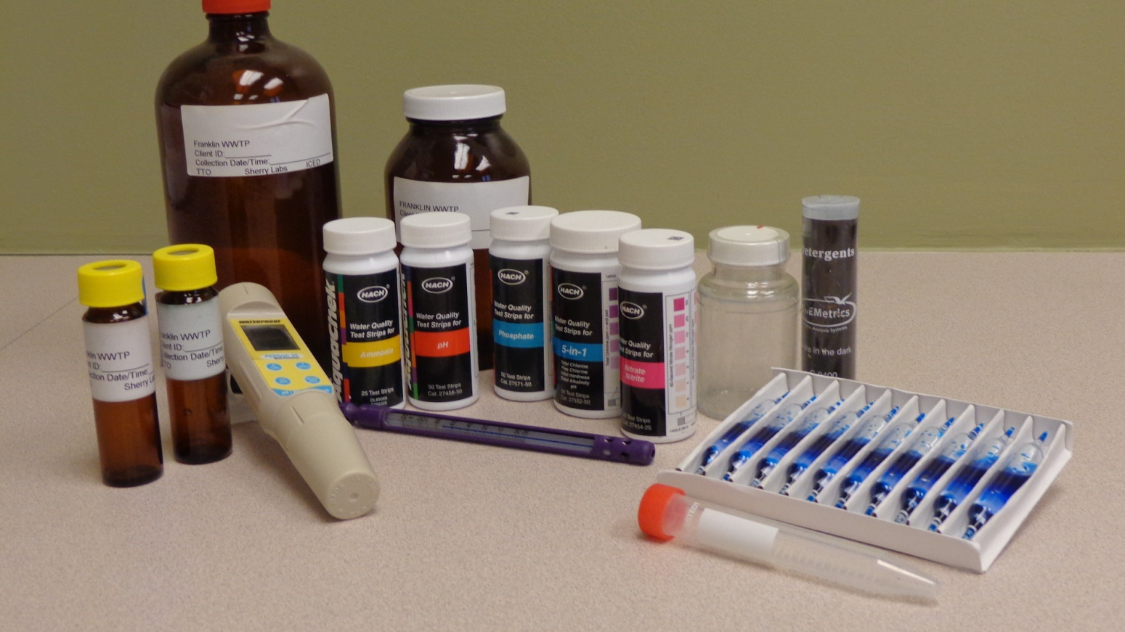
Outfall Inspection
Outfall Condition – Cracks, Stains, Odors , Is it dry or flowing.
Abnormal Vegetation or Poor Pool Quality.
Outfall Testing – (with flow).
Testing Parameters
Temperature
pH
E. Coli
Chlorine
Ammonia
Nitrate/Nitrite
Hardness
Turbidity
Detergents
Phosphorus
Testing standards are based upon current Indiana Water Quality Standards.
Test kits are the standard along with visual observation of color & smell.
WWTP – Provides advanced E.Coli testing in their lab for the MS4.

Slide 24
Outfall Inspection
Outfall Condition – Cracks, Stains, Odors , Is it dry or flowing.
Abnormal Vegetation or Poor Pool Quality.
Indiana Water Quality Standards
Temperature Summer Maximum limit 32.2C (89.6F)
pH Range of 6 – 9 pH units
Conductivity Range between 150- 500 μs/cm
Ammonia Range around 0.5 ppm
Chlorine Range around 0.4 ppm
Phosphorus Range less than 0.03 ppm
E. Coli Range less than 235 CFU/100ml
Nitrate/Nitrite Range less than 0.03 ppm
(If ammonia level exceeded.)
Turbidity Not to exceed 40 NTU
Hardness No range – regional geology
Detergents Range 0 – 1 ppm
Dissolved Oxygen Less than 4.0/ml
Outfall Testing – (with flow).
Testing Parameters
Temperature
pH
E. Coli
Chlorine
Ammonia
Nitrate/Nitrite
Hardness
Turbidity
Detergents
Phosphorus
Testing standards are based upon current Indiana Water Quality Standards.
Test kits are the standard along with visual observation of color & smell.
WWTP – Provides advanced E.Coli testing in their lab for the MS4.

Slide 25
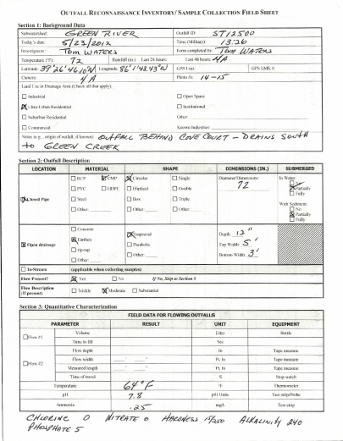
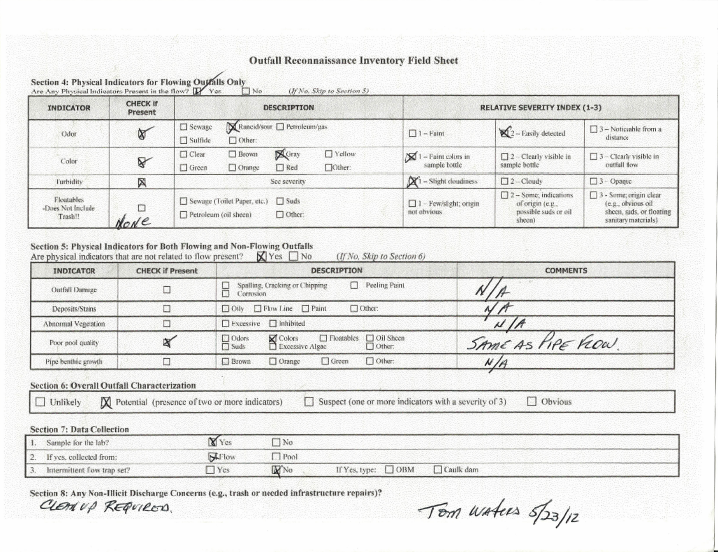

Slide 26
Investigating a Source – Investigate up the trunk of the outfall and sample stream.
Industrial Complex
Industrial
Agri-Business
Remediation Site
Commercial
&
Construction
Point Sources
Industrial/Commercial
Sewage
Wash Water
Waterline Breaks
IDDE/Dumping
Construction
Post-Construction
Residential
Outfall

Slide 27
Investigating a Source – Investigate up the trunk of the outfall and sample stream.
Industrial Complex
Industrial
Resolution:
Eliminate pollution source.
Immediate Clean-up or Remediation of source.
Agri-Business
Remediation Site
Commercial
&
Construction
Point Sources
Industrial/Commercial
Sewage
Wash Water
Waterline Breaks
IDDE/Dumping
Construction
Post-Construction
Residential
Outfall

Slide 28
On-going Monitoring:
Annual outfall monitoring of all water body outfalls.
Awareness of pollution potential hot spots – (Rule 6 Facilities).
Maintain a public education Illicit Discharge Detection Elimination program.
Goal – to maintain a healthy watershed.

